Slide 1
ZS Campus Beats 2021 Case Challenge
This document is solely for the use of client personnel. No part of it may be circulated, quoted or reproduced for distribution outside of the client organization without prior written approval of ZS.

Slide 2
Team details
Team Name | DIVERGENT
College Name | Indian Institute of Technology Guwahati
Team Leader | Tathagata Bhowmik
Team Member 2 | Nilay Pandey
Team Member 3 | Hrithik Kumar Verma

Slide 3
scenario Two – Business operations

Slide 4

Business Operations
OVERVIEW
01
Pulse Beverages, a leading nutrition drink manufacturer and seller in the US and India has employed Sales Managers to promote Aqua Orange, its unique drink in India.
02
ZS has been approached by the company to review the bonus evaluation process which is currently calculated based on performance against the sales targets set.
03
ZS is also required to design a sales compensation methodology and setup operations for administering the compensation plans.
4

Slide 5
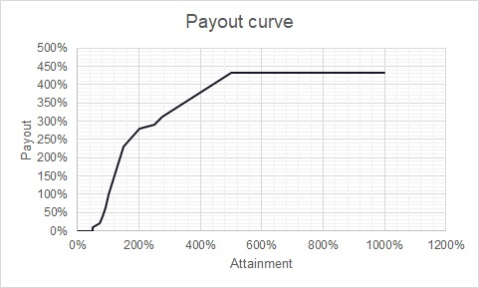
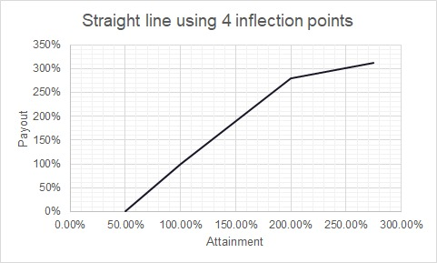
Part 1
Q1.1- Straight-line curve for the payout curve using the inflection points using dataset provided
From the Payout curve, we found out 4 inflection points at attainment value of 49,9%, 100%, 200%, and 275%.

Slide 6
Part 1
Q1.2 and 1.3
Manager ID | Manager Name | Q3- 2020 Goals(SU)
10011 | Rakesh S | 1,70,000
10012 | Kalpana K | 2,00,000
10013 | Ram S | 2,25,000
10014 | Taran S | 1,70,000
10015 | Rahul S | 2,35,000
10016 | Kirti S | 1,45,000
10017 | Vishwa P | 1,90,000
10018 | Ankit J | 1,80,000
10019 | Kirti S | 1,60,000
10020 | Abhishek S | 2,50,000
Payout
$ 36,300
$ 1,72,475
$ 1,46,175
$ 1,05,875
$ 7,58,800
$ 1,39,425
$ 1,99,925
$ 30,925
$ 3,32,900
$ 47,825
$ 7,58,000
Rahul S (10015) is the Sales Manager with the highest Payout bonus.
$ 1,15,050
This is the total Payout of the bottom 3 Sales Manager.
$ 1,970,625
This is the total spending of Pulse Beverages for incentives for Q3’20.

Slide 7
Part 2
Manager ID | Manager Name
10011 | Rakesh S
10012 | Kalpana K
10013 | Ram S
10014 | Taran S
10015 | Rahul S
10016 | Kirti S
10017 | Vishwa P
10018 | Ankit J
10019 | Kirti S
10020 | Abhishek S
Payout Difference of Q3 and Q1+Q2 combined
$ 24,336
$ 34,678
$ 44,651
$ 35,492.5
$ 4,45,058.5
$ 37,582
$ 52,548.5
$ 27,574
$ 45,726
$ 41,002
Question 2.1
As observed from the data, there is a massive growth in Payout in the 3rd Quarter as compared to both the previous two Quarters combined. This is mainly due to less revenue generation in the previous 2 Quarters as compared to the 3rd Quarter.
Question 2.2
The targets for the Sales Managers can be determined using the given formula:
Growth rate= [Q(n)-Q(n-1) / Q(n)]
Target(n+1)= Target(n)* [1 + Growth rate/3]
Where, Q(n)= Revenue of nth Quarter
Q(n-1)= Revenue of (n-1)th Quarter
Target(n)= Target of (n)th Quarter
Advantage- The formula sets the target considering the Sales Managers growth rate.
Disadvantage- Negative growth rate can lead to lesser target value than the previous one, which can impact the company’s revenue generation.
Question 2.3
$ 0
For Chennai for Q3’20, assuming we have 85% data from the top, and last 15% missing, attainment is 44.222% for which Payout is $ 0.

Slide 8
Part 3
Q3.1
Highlights
A monthly overview of the sales operations and activity of the company
Specific Sales KPIs
The performance dashboard which enable to track the customer acquisition costs, the average revenue per unit, and various other KPIs.
Graphs and Charts
It will not only summarize the major insights drawn out but also question the next steps.
Executive Sales Summary
To visualize all the data collected
Monthly Sales Growth
Customer Lifetime Values
Sales Target
Sales KPIs
Average Cost per Lead
Average Profit Margin

Slide 9
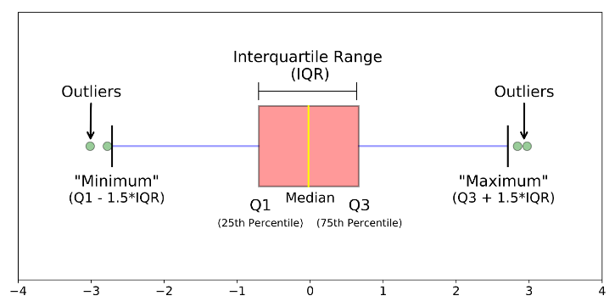

Part 3
Question 3.2
For ensuring the data provided in Part 1 is accurate, we can check for outliers with the help of Interquartile range (IQR). Any value that lies outside of the lower boundary(min value- 1.5IQR) and upper boundary(max. value + 1.5IQR) is an outlier, where IQR= 75 percentile value – 25 percentile value.
Question 3.3
In a rank-based plan based on growth in sales as compared to baseline period, Sales Managers receive a ranking on the basis of their sale, meanwhile Incentives is given based on this rank system. Setting a common baseline period for all the Sales Managers is not the best solution to track their growth since sales and their target can vary for each Sales Managers due to many factors as geography, market share, product variety etc. So, it wouldn’t be fair to change from goal-based plan to rank-based plan in sales.

Slide 10
THANK YOU! ☺

